Slide 1
BLOOD BANK

Slide 2
TABLE NAME: ADMIN
FIELD | DATA TYPE | SIZE | CONSTRAINT
Admin id | Int | 10 | Primary key
Username | Varchar | 20 | Not null
password | Varchar | 20 | Not null

Slide 3
TABLE NAME: DONOR
FIELD | DATA TYPE | SIZE | CONSTRAINT
Donor id | Int | 10 | Primary key
User type | Varchar | 20 | Not null
Name | Varchar | 20 | Not null
Age | Int | 10 | Not null
Blood group | Varchar | 2 | Not null
Mobile | Int | 10 | Not null
Username | Varchar | 20 | Not null
Password | Varchar | 20 | Not null
City | Varchar | 20 | Not null
District | Varchar | 20 | Not null
Pin code | Int | 6 | Not null
Address | Varchar | 20 | Not null

Slide 4
TABLE NAME: REQUEST
FIELD | DATA TYPE | SIZE | CONSTRAINT
Request id | Int | 10 | Primary key
Sender id | Int | 10 | Foreign key
Receiver id | Int | 10 | Foreign key
Sending status | Varchar | 5 | Not null
Receiving status | Varchar | 5 | Not null
date | Date | 10 | Not null

Slide 5
TABLE NAME: LOCATION
FIELD | DATA TYPE | SIZE | CONSTRAINT
Location id | Int | 10 | Primary key
Donor id | Int | 10 | Foreign key
Latitude | Varchar | 10 | Not null
Longitude | Varchar | 10 | Not null
Last location | Varchar | 10 | Not null
Current location | Varchar | 10 | Not null

Slide 6
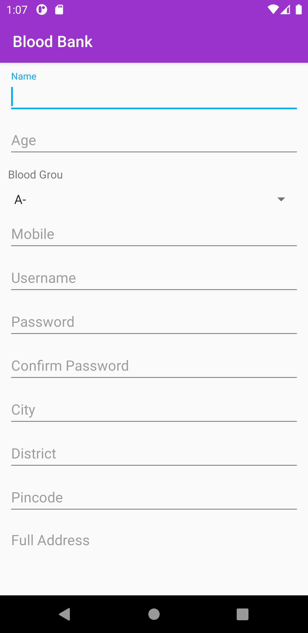

Slide 7
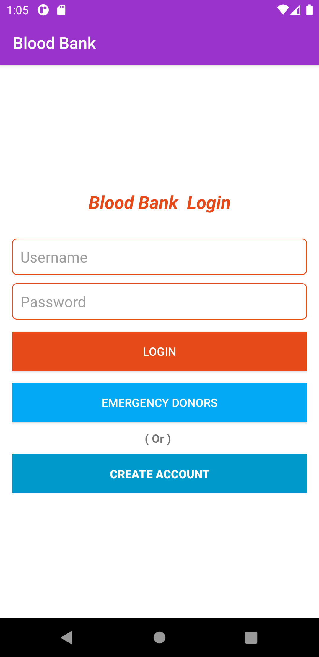

Slide 8
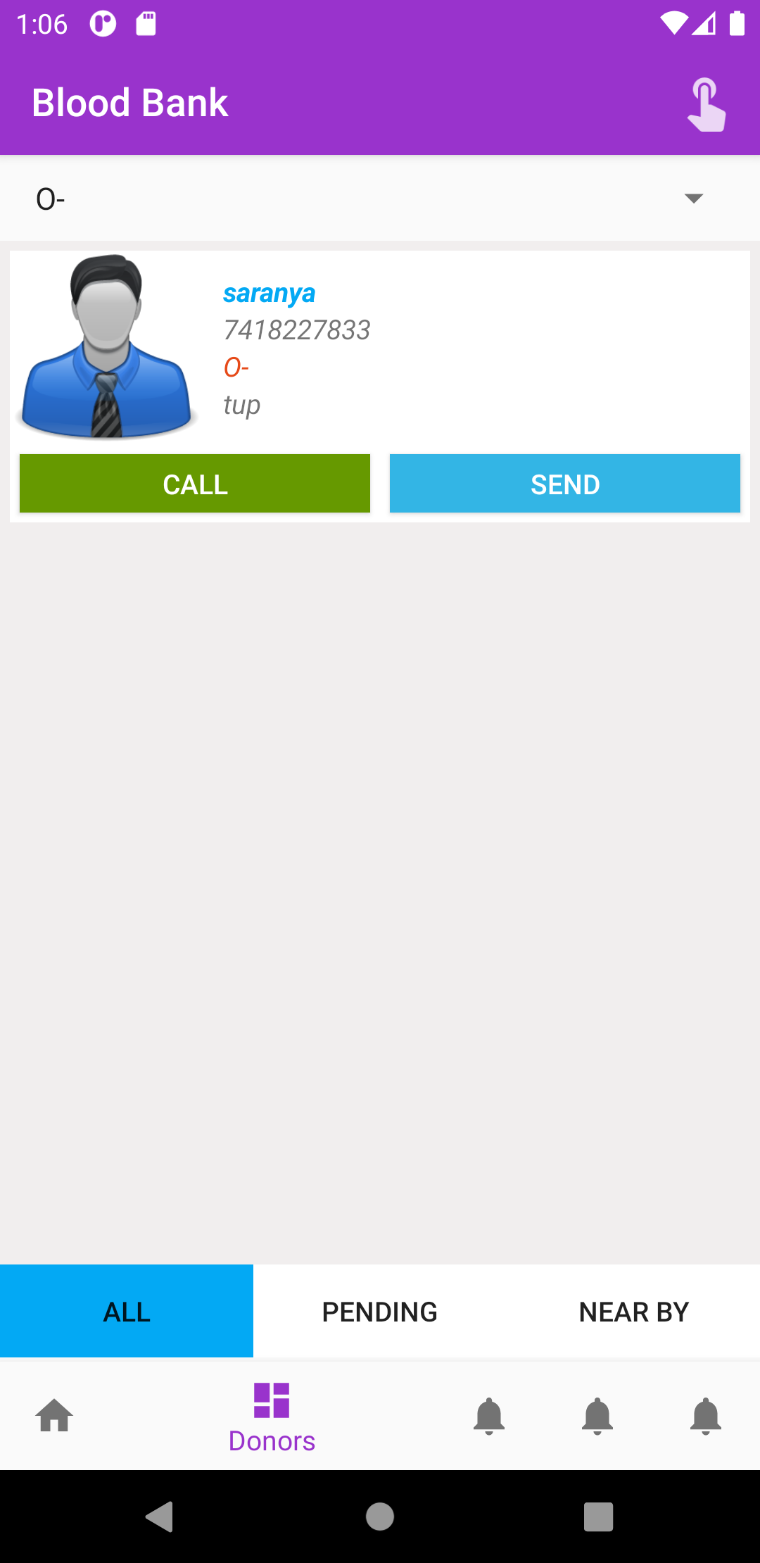

Slide 9
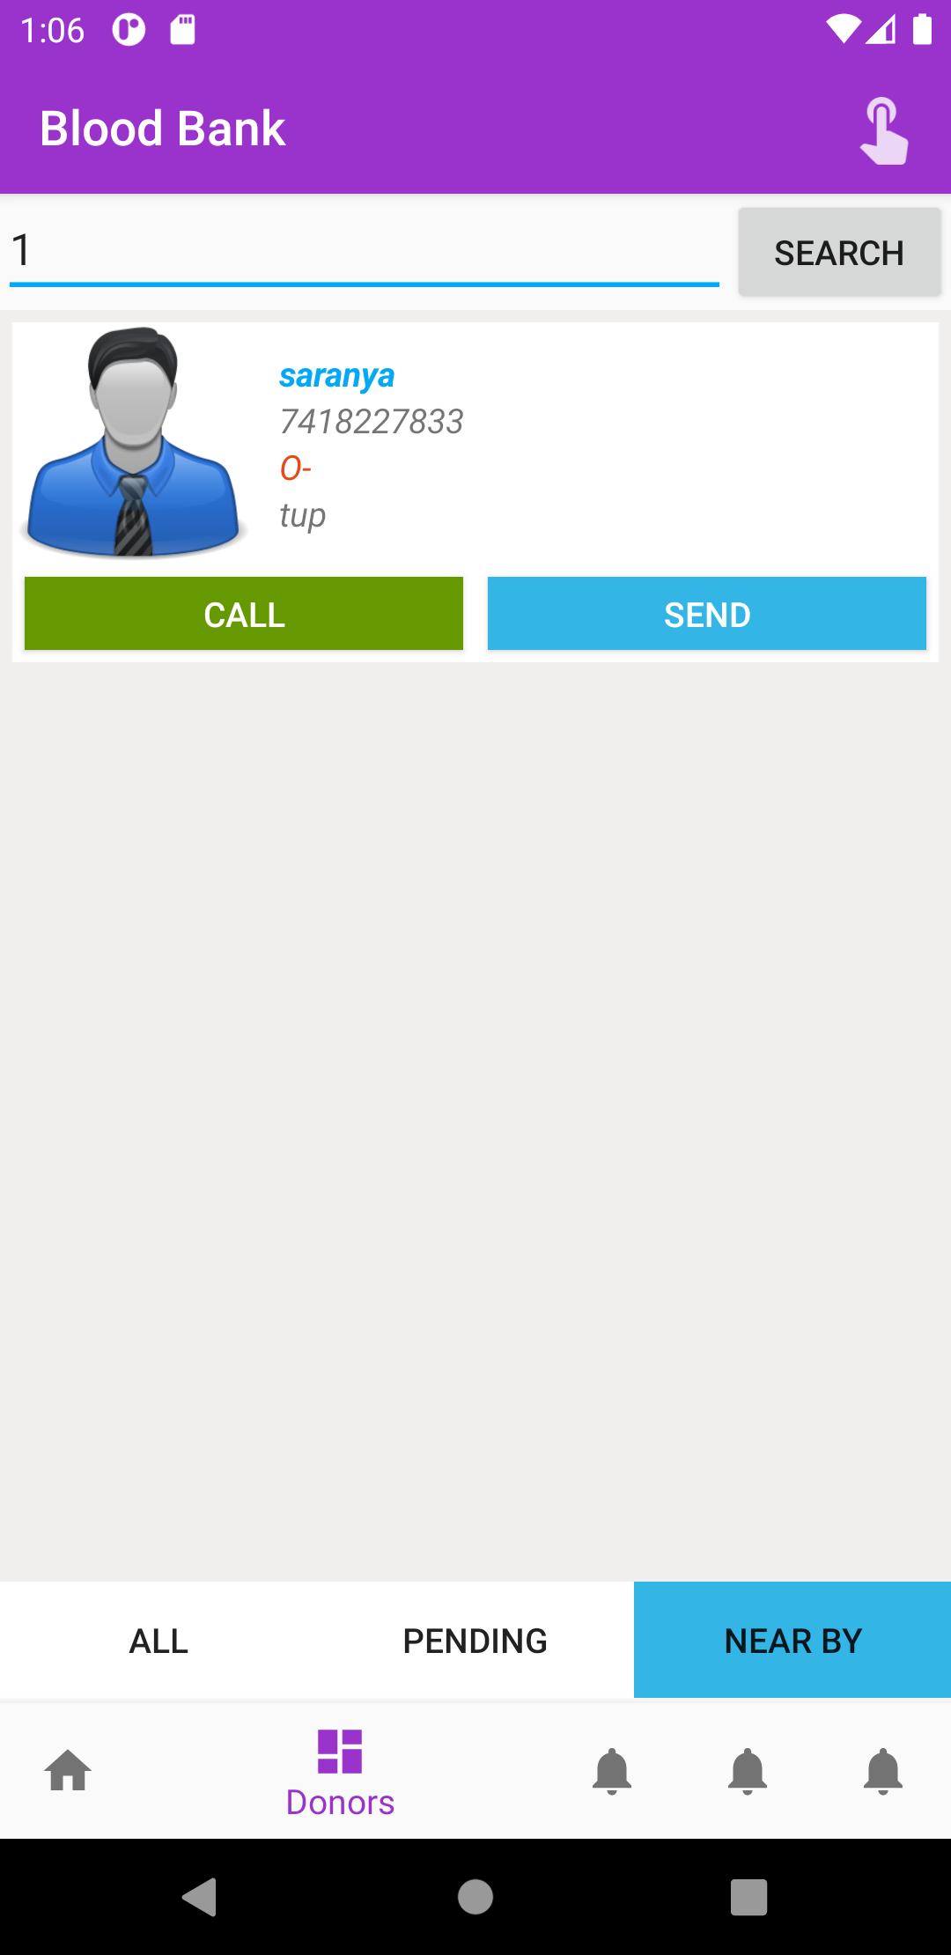

Slide 10
